Slide 1
Machine Learning Team 3
Ting zhang, ganghao li, hao zuo, jie lu, Reardon Michaela

Slide 2
Machine learning introduction
Machine learning is the art of using data to predict the outcome of future data. It is widespread in today’s technology including predictive text, facial recognition, fraud alert and shopping recommendations.
There are multiple types of machine learning tools such as Business Rule Management Systems (BRMS), Neural Networks, Deep Learning, Data Mining, Case-Based Reasoning (CBR), and Genetic Algorithms. These tools can be used in conjunction with each other to help hone in on features and model parameters.

Slide 3
Regular machine learning model
TensorFlow
Developed by Google
Open Source
Static Model Development
Option to use TensorBoard, a graphical representation of TensorFlow
Has multiple use methods (Python, JavaScript, Mobile, Production)
Lots of add ons available
Extended documentation, multiple tutorials

Slide 4
Regular machine learning model
PyTorch
Developed by Facebook
Open Source
Able to build Dynamic modeling
Simplistic, very similar to Python
Good support

Slide 5
Regular machine learning model
Keras
Lightweight
Developed by someone at Google
To be run on top of TensorFlow (or other)
Intended for fast prototyping

Slide 6
Recommendation for tensorflow
For the development of a static-machine learning model, the widely popular TensorFlow is a great option because of the extensive documentation and tutorials available. The static model allows for parallelism and faster, more efficient training

Slide 7
recommendation for tensorflow
Graphs
TensorFlow has better computational graph visualizations, which are indigenous when compare to others like Theano and Torch
Library
Backed by Google, TensorFlow as an open source library, has a huge collection of dataset. Also, quick update and new release with new features.
Scalability
TensorFlow can be used on various hardware machines, which cover from cell devices and computers.

Slide 8
TensorFlow model zoo
TensorFlow model Zoo

Slide 9
Introduction: TensorFlow MODEL ZOO
These models are API indeed and could work out well as long as users install and utilize them correctly through the guide. They are user friendly and the only thing the users need to do is to make sure that the category they are interested in is already in the datasets provided by the model zoo

Slide 10
Dataset
According to the description provided by Github TensorFlow developer, the main datasets provided by the model zoo cover:
1.COCO dataset which is provided by Microsoft and covers 91 object categories in daily life; 2.KITTI dataset which includes the driving condition object detection;
3.OpenImage dataset which is provided by Google;
4.AVA v2.1 dataset which contains multiple human action images;
5.iNaturalist Species dataset which includes almost all the species images in nature.

Slide 11
analysis of Pros
As an opensource API model, the model provided by the TensorFlow Detection Model Zoo are easy to use and run, especially easy on jupytor notebook.
Since the datasets that the models pre-trained on are provided by companies like Microsoft and Google who are good at collect big data, thus the datasets can be really big enough for the training. The training and prediction accuracy can be reliable.
The datasets cover most of object fields in our daily life and it cannot be difficult to find your interest category in their API.
Even instance segmentation could be implemented using mask-rcnn in some specific conditions. Not only the rough bounding box but also the featured segmentation could be shown to the users.

Slide 12
ANALYSIS OF cons
The hardware condition needs to be considered since the performance of the hardware could directly influence the speed of training and prediction of the model
To train an instance segmentation model, a groundtruth mask must be supplied for every groundtruth bounding box. Then this supervised machine learning labelling period can be complex for the users if they want to implement the instance segmentation.

Slide 13
General model
Detection: Model interface for users to easily implement their own model
Preprocess: shift the images before using as input in the detector
Predict: Produce “raw” prediction tensors which can be passed to further functions
Postprocess: Convert predicted output into final detections
Loss: Based on the groundtruth to compute the loss
Restore: Load a checkpoint into the TensorFlow graph

Slide 14
Model: mask-rcnn
Mask R-CNN can be implemented on Python 3 and TensorFlow. The model generates bounding boxes and segmentation masks for each instance of an object in the image.
Mask-RCNN extends Faster-RCNN via adding a branch for inferring segmentation masks on each Region of Interest(ROI), in parallel with the existing branch for classification and bounding box regression

Slide 15
Architecture

Slide 16
Results
Use Mask-RCNN model and generate with bounding box and mask

Slide 17
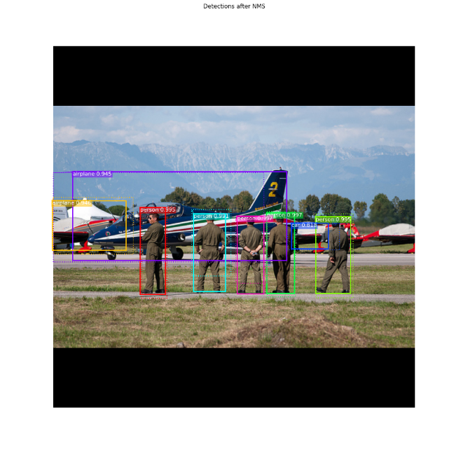
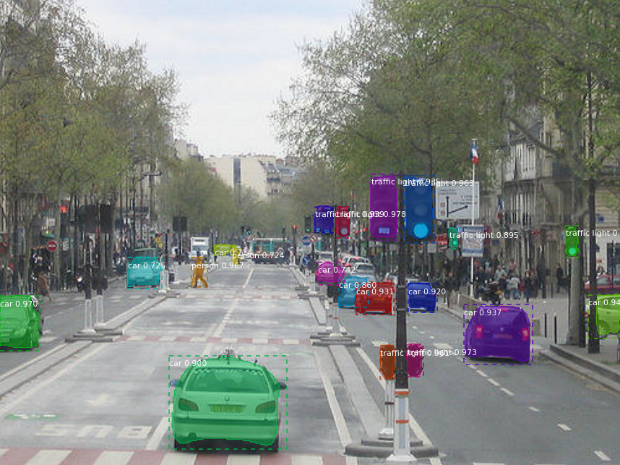
Results
Use Mask-RCNN model and generate with bounding box and mask

Slide 18
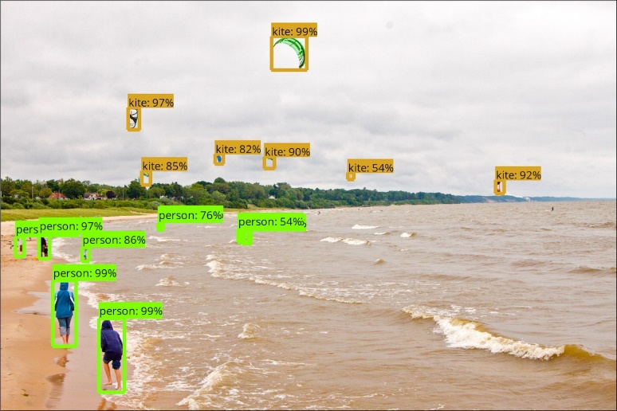
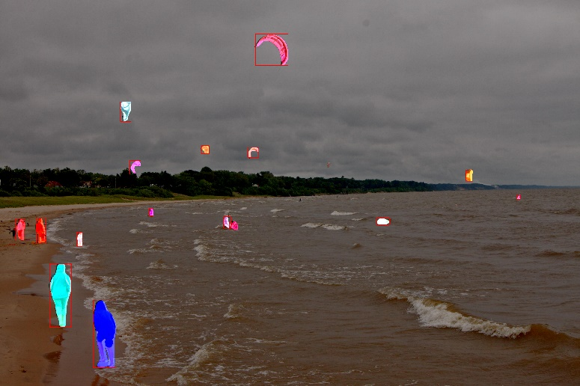
Results
Use Mask-RCNN model and generate with bounding box and mask

Slide 19
Model: YOLO Tensorflow ++
TensorFlow implementation of YOLO: Real-Time Object Detection, with training and an actual support for real-time running on mobile devices

Slide 20
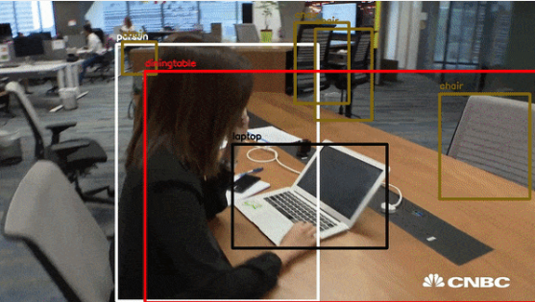
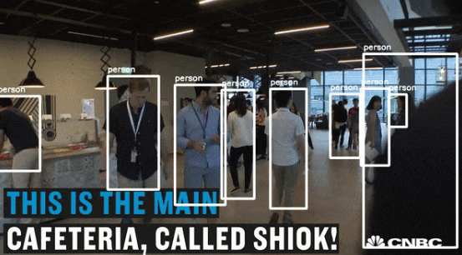
Results
Use YOLO Tensorflow ++

Slide 21
Recommendation
Learn the related algorithms before using the model or establish own models
Make sure to understand the pros and cons foe each model
Make sure to learn how to use each function and parameters properly
Choose the data set which is closer to the current situation in the training
Make sure you have a good hardware condition!

Slide 22
Unsupervised learning

Slide 23
Introduction: unsupervised learning
The various problems in pattern recognition are solved according to training samples whose categories are unknown (not marked)
One of the main methods: Cluster analysis. That is used in unsupervised learning to group, or segment, datasets with shared attributes in order to extrapolate algorithmic relationships.

Slide 24
Introduction: Clustering divides
Clustering divides the data set into different categories based on the data characteristics, so that the data within the category is relatively similar/correlated, and the data similarity/correlation between the categories is relatively small. We focus on two properties. The first property is consistency and the second property is association.

Slide 25
Analysis
Pros:
(1) No label & Clustering
Unsupervised learning is density estimation (look for descriptive data statistics), which means that can start working as long as it knows how to calculate similarity.
(2) Reduce dimension
Unsupervised learning need to extract features, or use layer/item clustering to reduce the dimension of data features.

Slide 26
Analysis
(3) Non-independent
For different scenarios, the distribution of positive and negative samples may have offset. Large offsets are likely to cause noise to the classifier, but for unsupervised learning’s situation is much better.
(4) Interpretable
The reason for the classification of supervised algorithms is unclear, because these rules are derived by manual modeling and cannot be self-generated. Unsupervised clustering is well explained. Because the elements in one group have similar features and consistency.

Slide 27
Analysis
(5) Expandability
A n-dimensional model, if is added into a very strong feature, which will break up the original classification. The unsupervised algorithm is scalable. No matter how high the weight of this multi-dimensional data is, it does not affect the original result output. The original result can still be retained, and only needs to process new dimension data.

Slide 28
Analysis
Cons:
(1) Accuracy and validity
Because researchers can set the label for the supervised learning in advance, which means supervised learning can be run in a more reasonable way under control. But for unsupervised learning, it learns objects in its own logic analysis without any one interfering, so it may have unpleasant results.

Slide 29
Applied field
(1) Data mining
Unsupervised learning is often used for data mining to find out what is in a large amount of unlabeled data. Its training data is unlabeled, and the training goal is to classify or distinguish observations.
(2) Abnormal detection
Unsupervised learning classifies the objects according to their features, so if the abnormal objects have little consistency with other groups, they will be detected. For example, it always be applied to anti-fraud in finance industry.

Slide 30
Applied field
(3) Detect a segment objects
It can be used in recognizing segment objects. For example, Computer Vision in Unmanned vehicle will use this method to detect the roads, lines and traffic lights.
(4) Advertisement
Applying this method to find users’ interest based on what the users usually search or browse and then advertise precisely.

